Slide 1
Time to Succeed
Managing your university workload and learning to enjoy what you do
Dr Kevin Watson: Centre for Academic Development

Slide 2
Tip 1: Take time to reflect

Slide 3
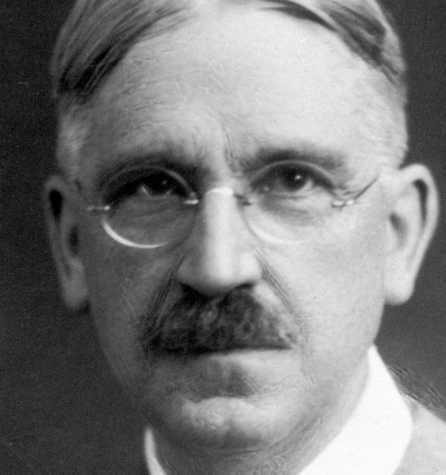
John Dewey
“We do not learn from experience; we learn from reflecting upon experience.”

Slide 4
Explore the Head into Brookes online course to start the process of reflecting on university before you arrive.
Start the Head into Brookes Course (takes you to course home page)

Slide 5
A skills audit can help you explore what strengths you are bringing to university and what skills and qualities you might want to develop. Centre for Academic Development Skills audit page.

Slide 6
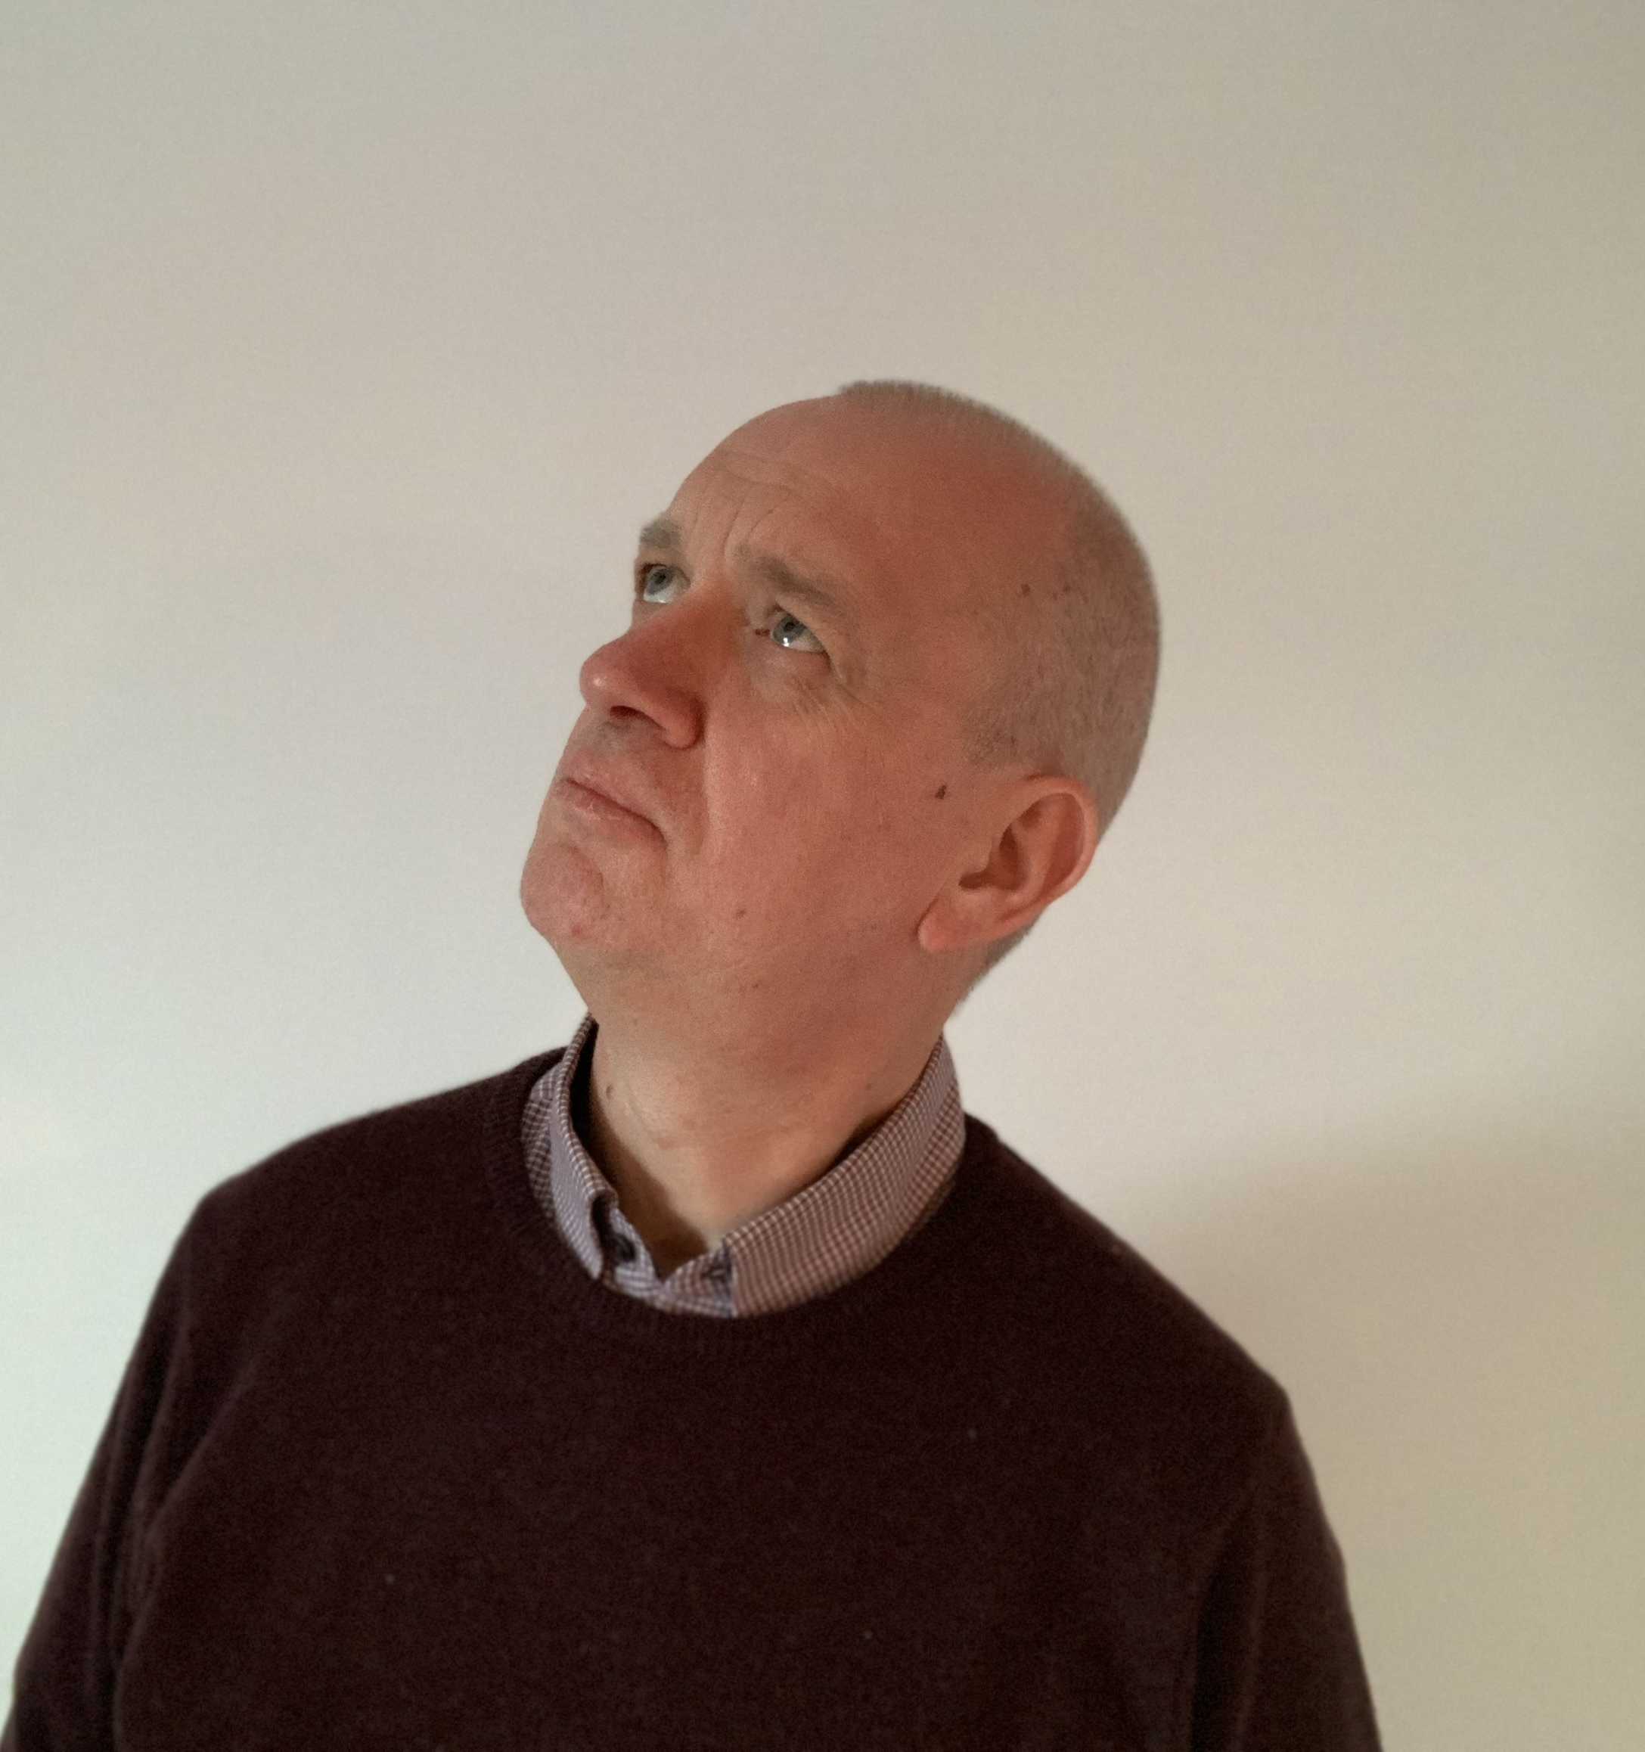
Tip 2: Take time to question
?
?

Slide 7
Critical thinking resources from the Centre for Academic Development
?
?
?
?
?
?

Slide 8
Tip 3: Save time by always having a purpose to reading and notemaking
Words to make
your head hurt

Slide 9
It is important to read and make notes strategically
Crime and Punishment Through the Ages
3 web pages
15 articles
15 books
= 33 sources for 1 week
4 modules
= 33 x 4 = 132 sources in 1 week!

Slide 10
Centre for Academic Development Reading Page
Centre for Academic Development Notemaking Page

Slide 11
Tip 4: Give your curiosity time to breathe.

Slide 12
The reflective tips
Take time to reflect.
Take time to question.
Save time by always having a purpose to reading and notemaking
Give your curiosity time to breathe.

Slide 13
Tip 5: Plan backwards from deadlines

Slide 14
Tip 6: Break assignments into manageable tasks

Slide 15
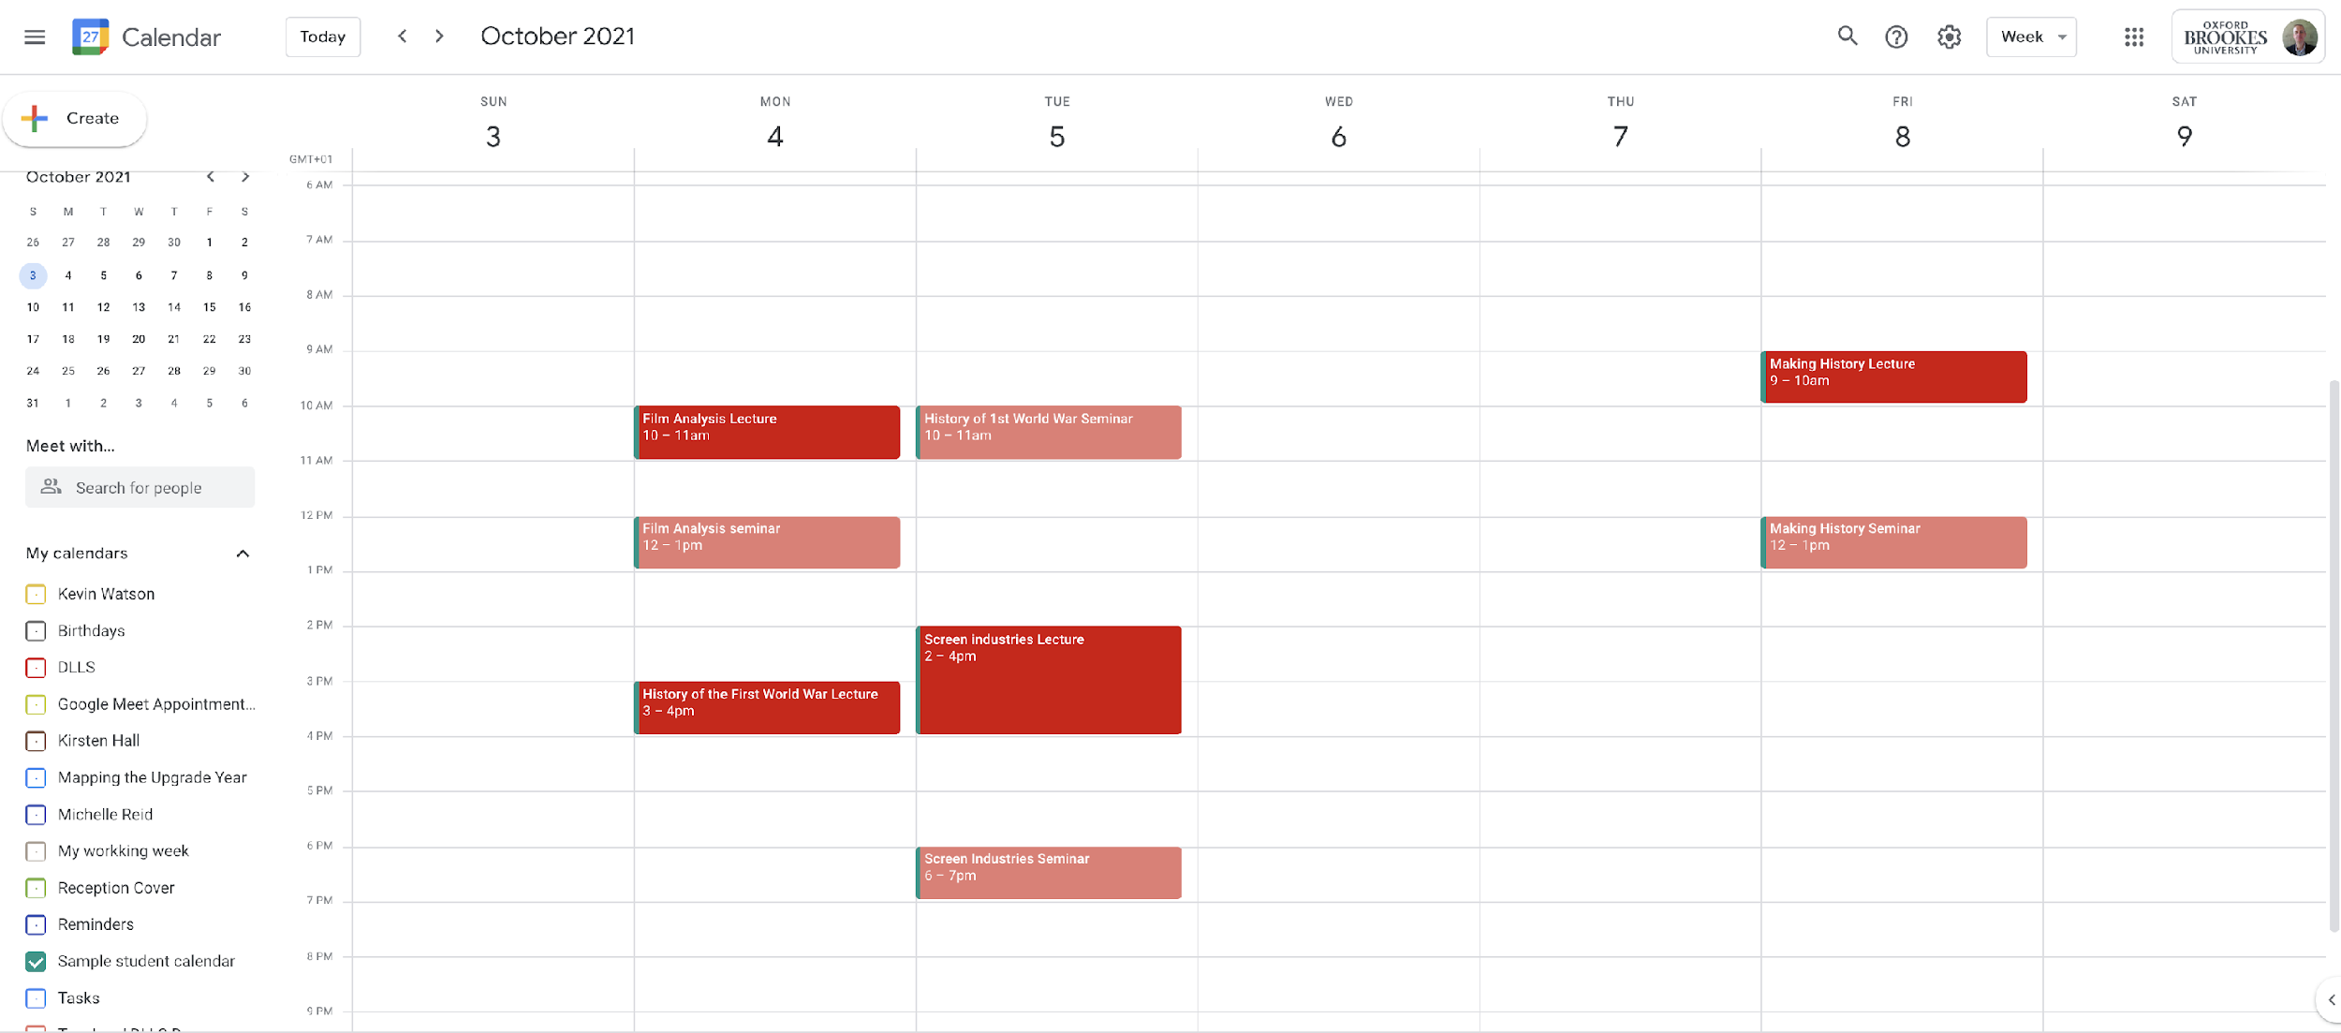
Sample timetable: Not looking busy is it?
Notes:
Introduce staff and student ambassadors.
Make sure students are aware that the links are live in PDF version of presentation.

Slide 16
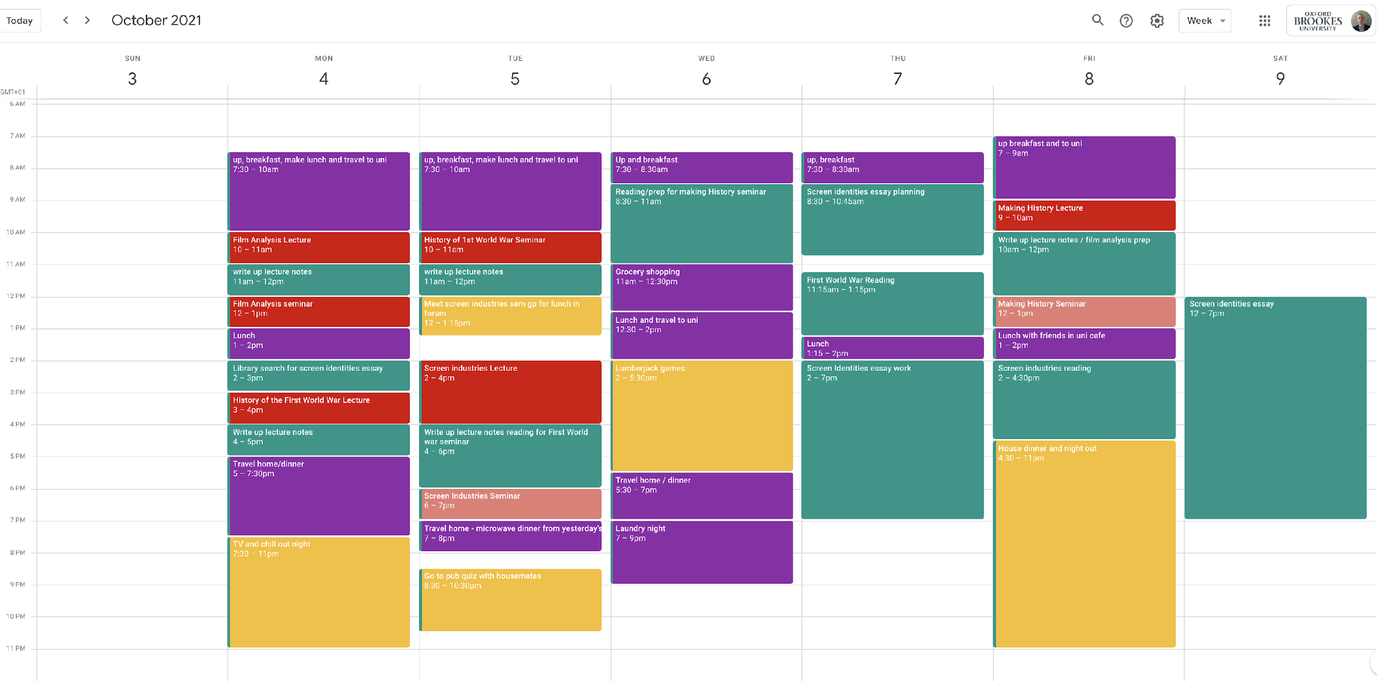
This version has tasks added that a student needs to do for each course plus time spent on things like travel, cooking and laundry. Suddenly it looks busy!

Slide 17
Tip 7: Take time to organize yourself
Check your emails regularly.
Review your schedule regularly by task as well as event.
Plan ahead with the short, medium and long-term in mind.
Organise paper and digital files into folders that you can confidently access.
Familiarise yourself with the learning technology we use so that you can use it efficiently (e.g. google apps, Microsoft Office, Zoom, moodle.

Slide 18
Tip 8: Take time out!

Slide 19
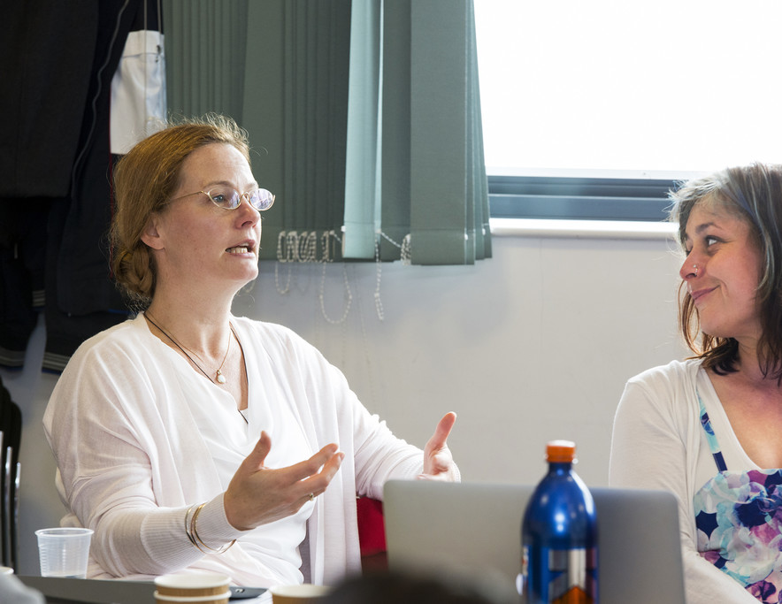
Tip 9: Take time to meet people

Slide 20
Tip 10: Take time to enjoy what you do.

