Slide 1
Feeling Accepted
Claire Burgess
Soar Development Ltd

Slide 2

Imposter Syndrome
When self-doubt turns into fear of being found out as a phony/fraud
Belief that the confidence others have in your abilities is wrong
70% of people have experienced it
Try to look objectively at success
What you have achieved and what you did to make that happen

Slide 3
Learning Styles
Activists:
Involve fully in new experiences
Enthusiastic about the new
Act first
Bored with implementation and long term
Learn by doing, doing, doing
Reflectors:
Stand back and think
Collect data, think about it before coming to conclusion
Consider all possible angles before making a move
Prefer to take a back seat in meetings
Enjoy observing others

Slide 4
Learning Styles
Theorists:
Often create complex and logically sound theories
Think problems through in step-by-step way
Keen on basic assumptions, principles, theories and models
Often ask “does it make sense”
Tend to be detached, analytical and objective
Pragmatists:
Keen on trying out ideas, theories and techniques to see if work in practice
Search out new ideas and experiment with applications
Come back from courses wanting to try out all ideas
Enjoy making practical decisions and solving problems
Act quickly and confidently on ideas that attract them

Slide 5
Personality
Scale | High | Low
Openness | Imaginative, curious | Down to earth, conventional
Conscientiousness | Well organised, punctual | Disorganised, poor time keeping
Extraversion | Talkative, joiner | Reserved, passive
Agreeableness | Good natured, lenient | Critical, irritable
Neuroticism | Worried, temperamental | Calm, even-tempered

Slide 6
Discussion
How could you lessen the impact of Imposter Syndrome if it occurs?
Which learning/personality style do you identify with? How could this understanding help you to understand others (and they understand you)?

Slide 7
Communication process

Slide 8
Communication method

Slide 9
Building rapport
Shared interests
Listening
Respect
Give and take
Values

Slide 10
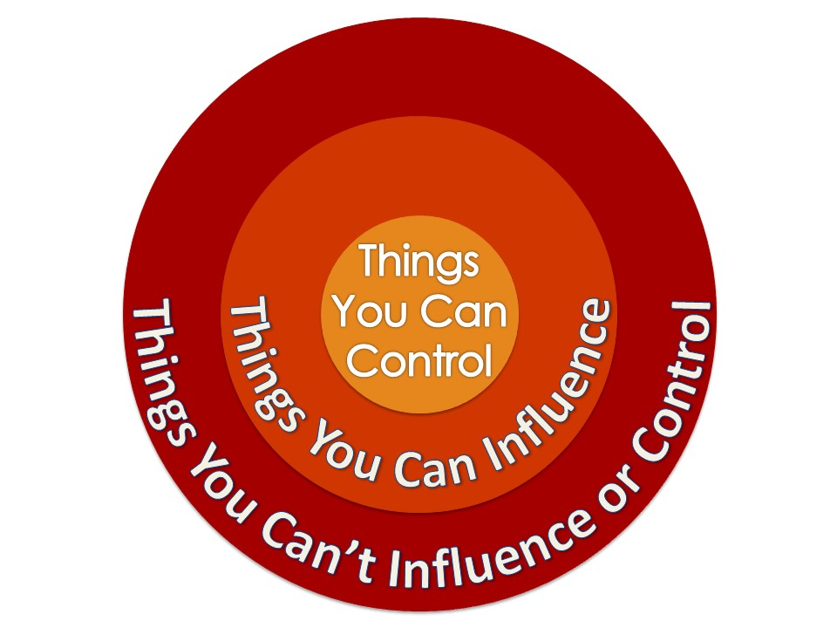
Effective group working
All work to strengths – learning what each does well
Work together to achieve goals
Work together on challenges – acknowledge change
Support each other through ups and downs
Note positives – 2:1 feedback ratio as well as reflection

Slide 11
Discussion
Share thoughts and tips on developing relationships with others, particularly those from different backgrounds and age groups.
Which of the ideas shared here would help you to do this in a new situation?

Slide 12
Adult Ambassador

Slide 13
Questions?

