Slide 1
Managing Anxiety and Change
Claire Burgess
Soar Development Ltd

Slide 2
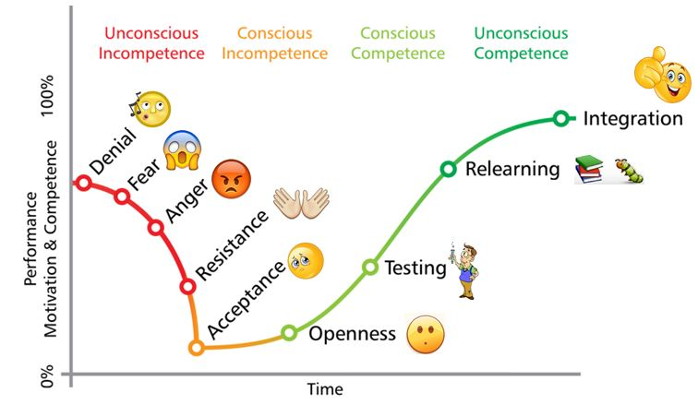
Going through change

Slide 3
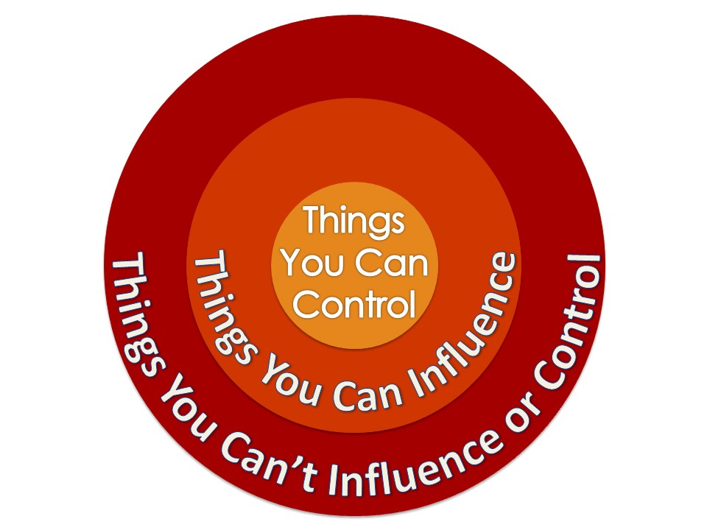
Circles of Control and
Influence
Importance of present-focus
Organisation and writing things down makes things more rational

Slide 4
Resilience
Managing difficult situations, keeping focused
We can develop this – but it’s not about just keeping going, linked to our wellbeing
We are more able to be resilient when we are rested, energised and look after ourselves
Also acknowledging how we’ve dealt with past setbacks
Dealing with a lot of change can drain our resilience levels

Slide 5

Wellbeing activities
Music
Something that makes you laugh
Social connection
Being outdoors
Exercise
Gratitude practice
Hobby/interest
Acts of kindness
Learning a new skill
Relaxation
Set a goal

Slide 6
Discussion
What actions could you take to develop your resilience and manage change?
What wellbeing goals can you set yourself?

Slide 7
Stress
“Stress occurs when the perceived pressure exceeds your perceived ability to cope.”
Links to lack of control
Importance of wellbeing, mindset and resilience
Fight/flight/freeze – need to use rational brain
Notice thinking
Unhelpful
      Labelling – I’m just not up to it
      Catastrophising – If I don’t get this done, it will be a disaster
      Over-generalising – I always get this sort of thing wrong
Helpful
      I am good enough
      I can do what is needed towards the success of the project
      I got this wrong this time, but I can do it differently

Slide 8

Positive Mindset
A positive mindset is not about being ‘happy’ all the time, but instead it’s about focusing on what you can control
  Your reaction
  How you think about situations
  Focusing on making the best of things and moving forwards
Actions:
  Choose to be positive
  Take personal responsibility (more active than passive or a ‘victim’)
  Understand your impact
  Set huge goals

Slide 9
Optimism
Optimism vs. Pessimism
Optimistic explanations
  Internalise successes, permanent
  Externalise failure, temporary
  Hope for the future

Slide 10
Discussion
Which of these areas do you do well, and which could you improve?
How could you be more aware of your mindset and make shifts to help counter feelings of anxiety/worry?

Slide 11
Adult Ambassador

Slide 12
Questions?

