Slide 1
Lack of confidence and fear of failure
Claire Burgess
Soar Development Ltd

Slide 2
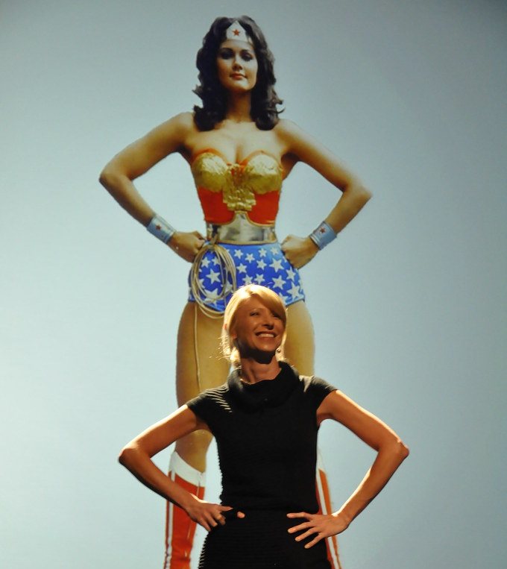
Confidence
Following from self-belief - show yourself you can do it! Develop through practice.
Body language
  ‘Power pose’
  Eye contact
  Own your space
Act ‘as if’
Amy Cuddy’s ‘Power Pose’

Slide 3
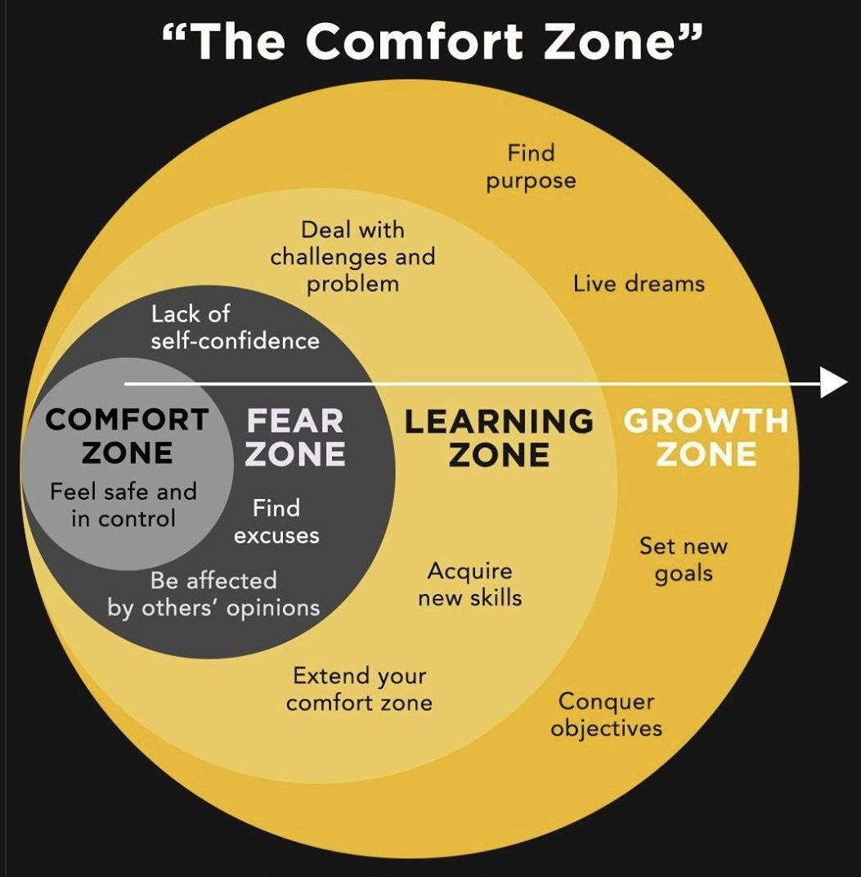
Importance of practice

Slide 4
Self-talk
You are what you tell yourself – try to develop a positive self-talk rather than negative
We are our own worst critics! But would you talk to a friend the way you talk to yourself sometimes?
  Watch out for the ’mind monkeys’
Notice it and balance with kind words
  Focus on positives not just negatives, in the present and when thinking about the past

Slide 5
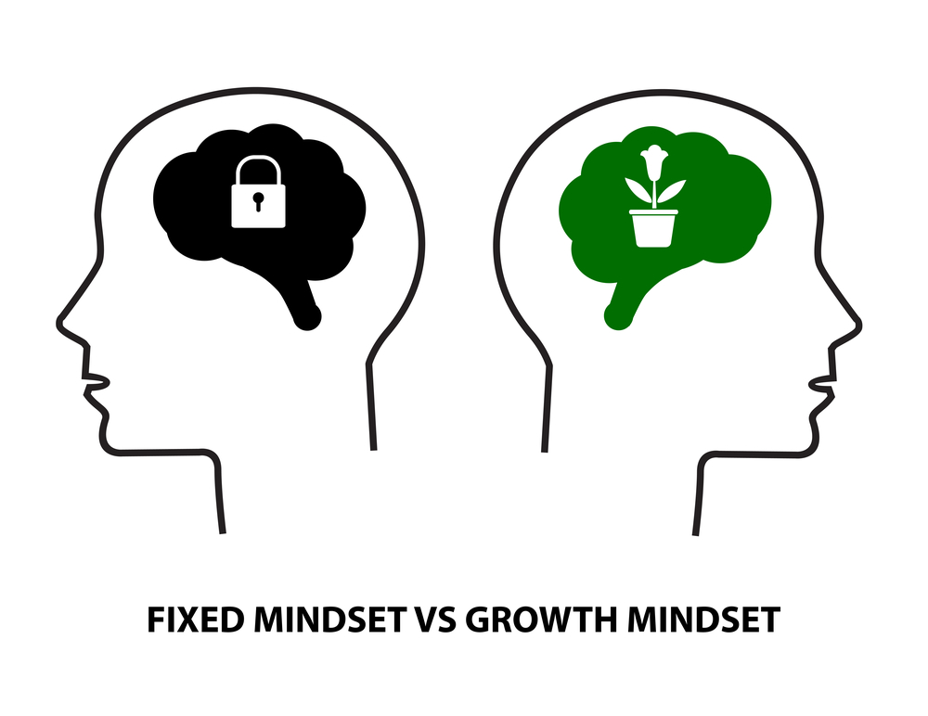
Fixed vs. Growth mindset
Carol Dweck
Fixed mindset= belief that your qualities and intelligence are carved in stone
Growth mindset= everyone can change and grow through learning and experience
Failure is to be feared vs. failure is learning
‘Learners vs. non-learners’
Expectations of yourself (and others’ expectations)

Slide 6
Discussion
What can you do personally to move out of your comfort zone and to move to a growth mindset?
Explore your thoughts on these areas and decide what small actions you can commit to.

Slide 7
Motivation
Positive and negative motivation
Internal vs. external
  Internal: e.g. goals, self-drive, self-belief, passion, enthusiasm, beliefs about the world
  External: e.g. rewards, threats, recognition from others, praise, achievement, expectations on you
Everyone is different!

Slide 8
Discussion
Discuss and then write down as many internal and external motivators that you can think of.
Then, discuss how you could use these to help you get motivated when you are struggling (for example, if reward is a motivator how you could you give yourself small rewards)

Slide 9
Adult Ambassador

Slide 10
Questions?

