Slide 1
Identifying Your Strengths
Claire Burgess
Soar Development Ltd

Slide 2
Strengths
Alex Linley (2008): “A strength is a particular way of behaving, thinking or feeling that enables optimal performance which is both authentic and energising”
Personal/character strengths and performance strengths
Assessment: www.viacharacter.org, www.strengthsprofile.com
Over-used strengths

Slide 3
Strengths examples
Curious
Flexible
Determined
Sincere
Decisive
Creative
Conscientious
Playful
Spontaneous
Calm
Analytical
Organised
Appreciative
Notes:
Complete strengths self-assessment.
Speed networking if needed.

Slide 4
Discussion
How can you use your strengths to help your learning as an adult?
Explore what you consider to be your strengths and how to draw on these to help within your learning

Slide 5
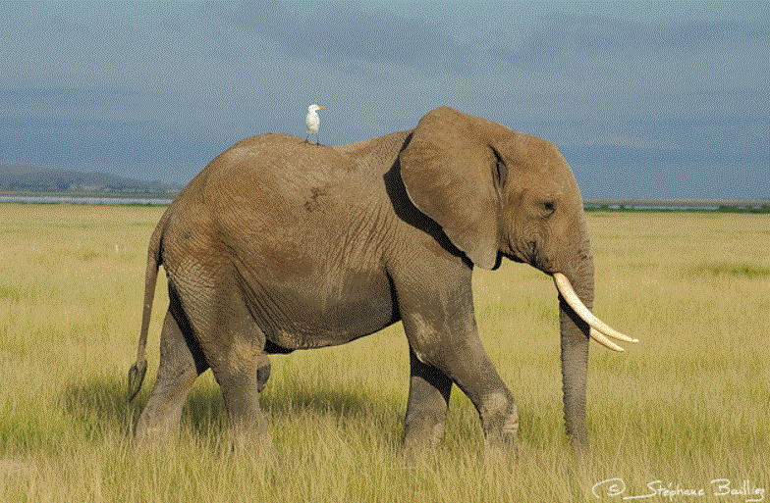
Goals
‘Well-formed outcomes’ – from NLP
Important that your goals balance with other areas of your life, are in your control and framed positively
Impact of visualisation – RAS in brain
HUGG – from ‘The Art of Being Brilliant’
Have a huge goal and make it manageable

Slide 6
What do you want?
Use positive language
What are the consequences on other things and people?
What will I gain when I have outcome?
What will I lose?
Does this fit with all aspects of my life?
Can you initiate and do it?
Must be something you can actively do something about.
An outcome for yourself, not others.
Well formed outcomes
Positive
In your control
Specific
Context
Impact
Resources
What do you need?
Internal e.g. skills, knowledge, time, frame of mind, health and fitness
External e.g. support, money, equipment, information, contacts.
What do I have now and what do I need to acquire?
What or how specifically?
Need a clear outcome e.g. how much money specifically do you want to earn
What do you see/feel/hear – use senses
When, where and with whom?
Add the context to your outcome

Slide 7
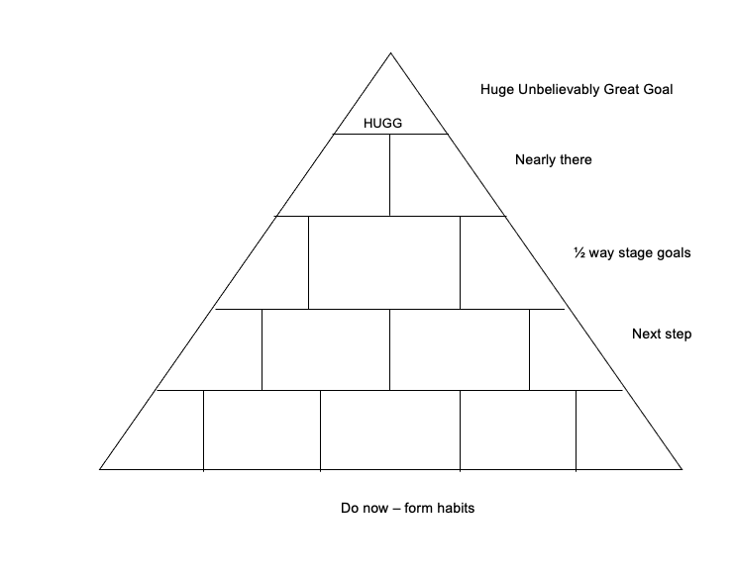
HUGG Pyramid

Slide 8
Beliefs
“Twenty years from now you will be more disappointed by the things you didn’t do than by the things you did do, so throw off the bowlines, sail away from safe harbour, catch the trade winds in your hair. Explore, Dream, Discover.” Mark Twain
“Whatever you can do, or dream you can do, begin it. Boldness has genius, power and magic in it.” Goethe
“Whether you think you can, or think you can’t, you’re right!”
Henry Ford

Slide 9
Beliefs
Belief
Behaviour
Results
Conclusion
Consider: What baby steps can you take to prove your self-belief wrong?

Slide 10
Adult Ambassador

Slide 11
Questions?

